Slide 1
Japan
The Studios’ transitions during WWII give us an opportunity to discuss history as viewed through a different, and sometimes difficult prism. It also prepares us to look at Animation in

Slide 2
A Little History
First ….

Slide 3
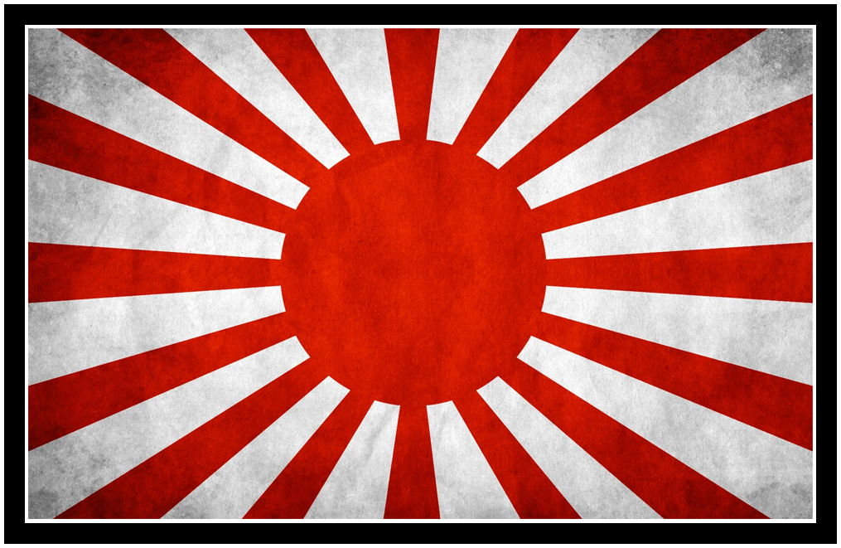
Land of the Rising Sun

Slide 4
Japan’s Twentieth Century
Dominated by Conflict
Russo – Japanese War 1904
Russian Revolution
Revolt in 1905 (Brutally Put Down)
WWI 1914
Aristocracy Overthrown, March 1917
Bolsheviks Come to Power, October 1917
Soviet – Japanese Conflicts
1919 – 1930 Border Conflicts

Slide 5
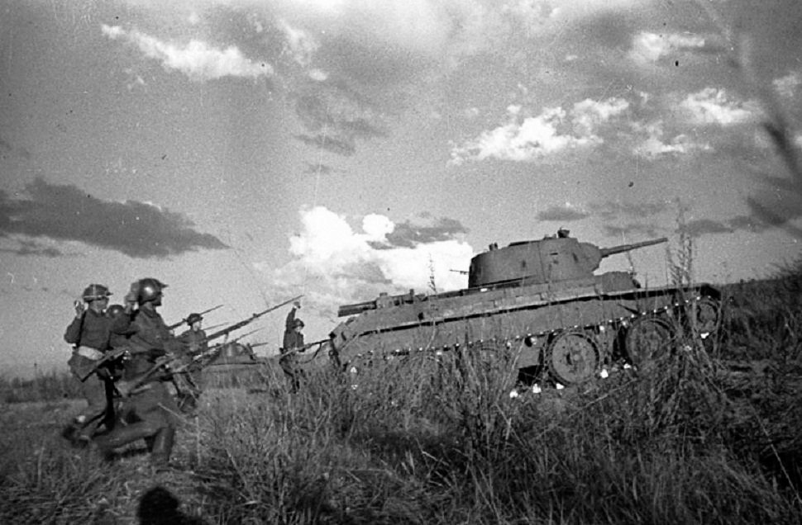
Japan’s Twentieth Century
Soviet – Japanese Conflicts (151 Recorded Incidents)

Slide 6
Japan’s Twentieth Century
October 1929: Global Economic Disaster
Japan loses a resource partner, the U.S.A.

Slide 7
Japan’s Twentieth Century
October 1929: Global Economic Disaster
Japan loses a resource partner, the U.S.A.
Japan had invested heavily in the South Manchuria Railway company.
Has a military force already in place in Northern China.

Slide 8
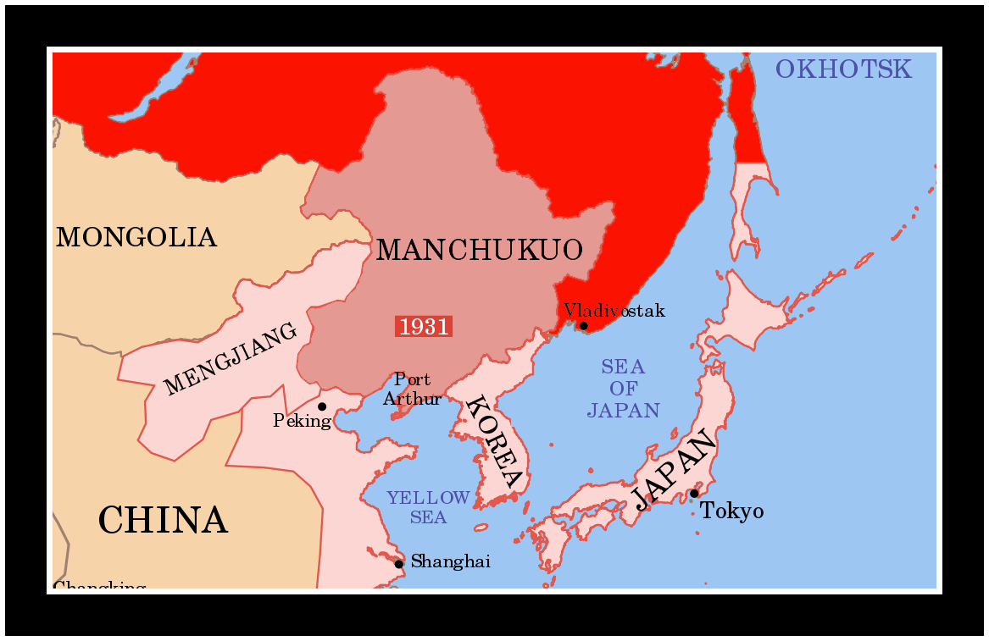
Japan’s Twentieth Century
Invades Manchuria
in 1931

Slide 9
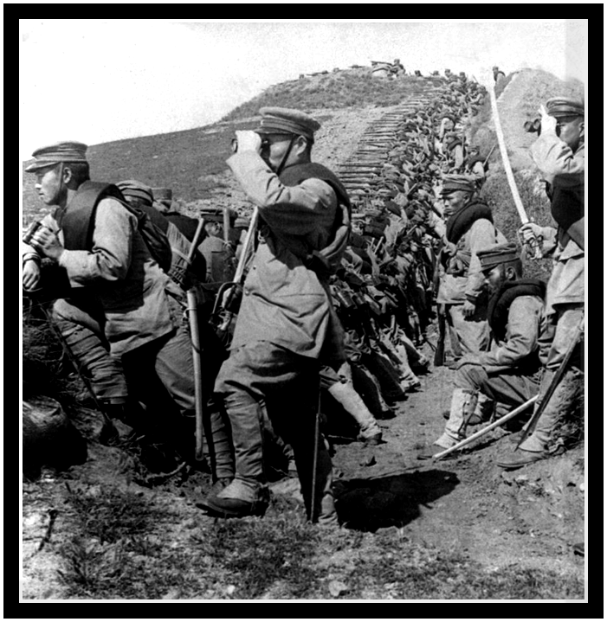
Japan’s Twentieth Century
Invades Manchuria
in 1931
Largely a political
overthrow, despite a
military presence.
The former Chinese
Emperor is made a
puppet and forced to
sign an alliance giving
Japan power in north
China.

Slide 10
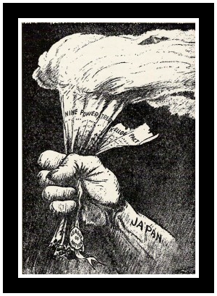
Japan’s Twentieth Century
Invades Manchuria
in 1931
This action, condemned by
League of Nations, led
Japan to step away from
the organization.

Slide 11
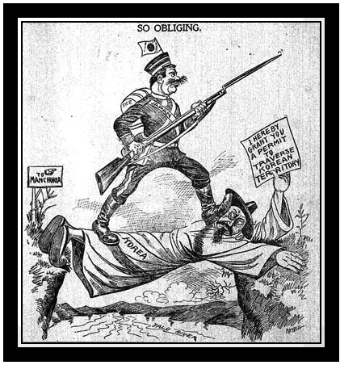
Japan’s Twentieth Century
Invades Manchuria
in 1931
Further antagonizes
the Korean people, who
are under Japanese
colonial rule at this time.

Slide 12
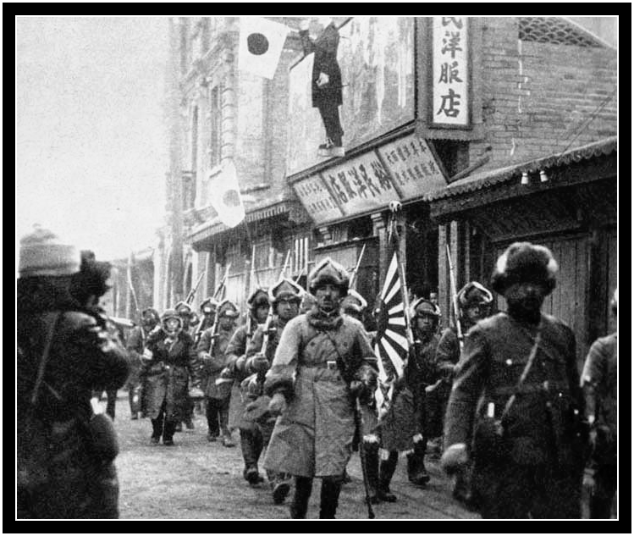
Japan’s Twentieth Century
From Manchuria, invasion
spreads into mainland China
in 1937. This is a brutal military
action.
In December of 1937, Japanese
soldiers kill 300,000 Chinese
civilians in Nanking.
The U.S. and the free world
react in protest, but little
comes of it.

Slide 13
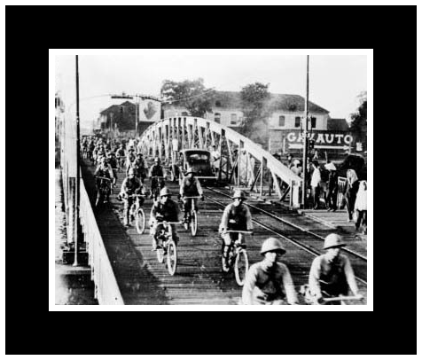
Japan’s Twentieth Century
1939, Germany and USSR
invade Poland. France and
the UK declare war on
Germany. In 1940 France falls.
At the same time Japan moves
quickly to seize military bases
in French Indochina.
Congress approves expenditures
to upgrade the US Navy – specifically aircraft carriers.

Slide 14
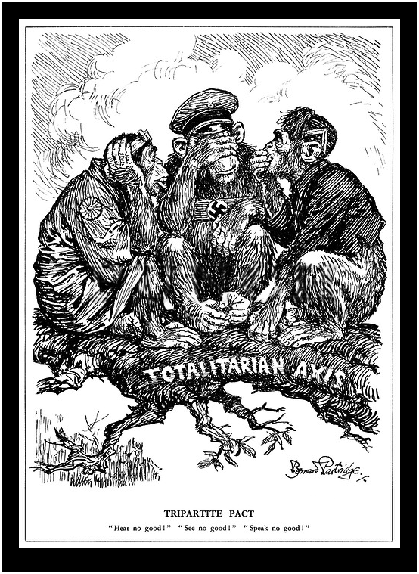
Japan’s Twentieth Century
Japan reacts by forming
alliance with two other
countries that have been
censured by the League of
nations: Germany and Italy.
U.S. seizes all Japanese assets
in the country. Embargo placed
on all oil, iron, and steel exports.
UK and the Netherlands follow
the U.S. lead.

Slide 15
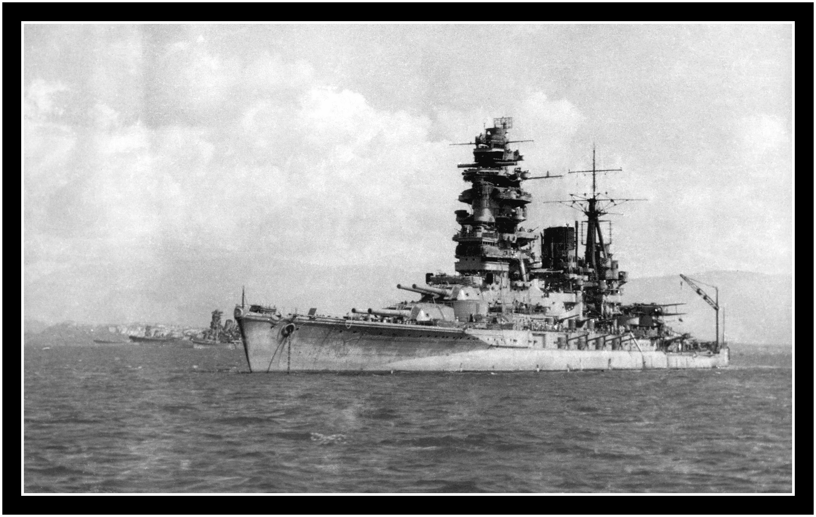
Japan’s Twentieth Century
Japanese expansion in the
in the Pacific, China, &
Indochina cannot be
maintained without raw
materials.

Slide 16
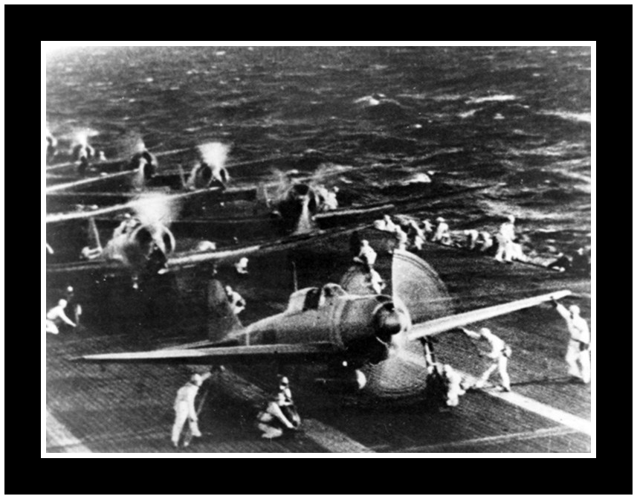
Japan’s Twentieth Century
This leads to a wild gambit:

Slide 17
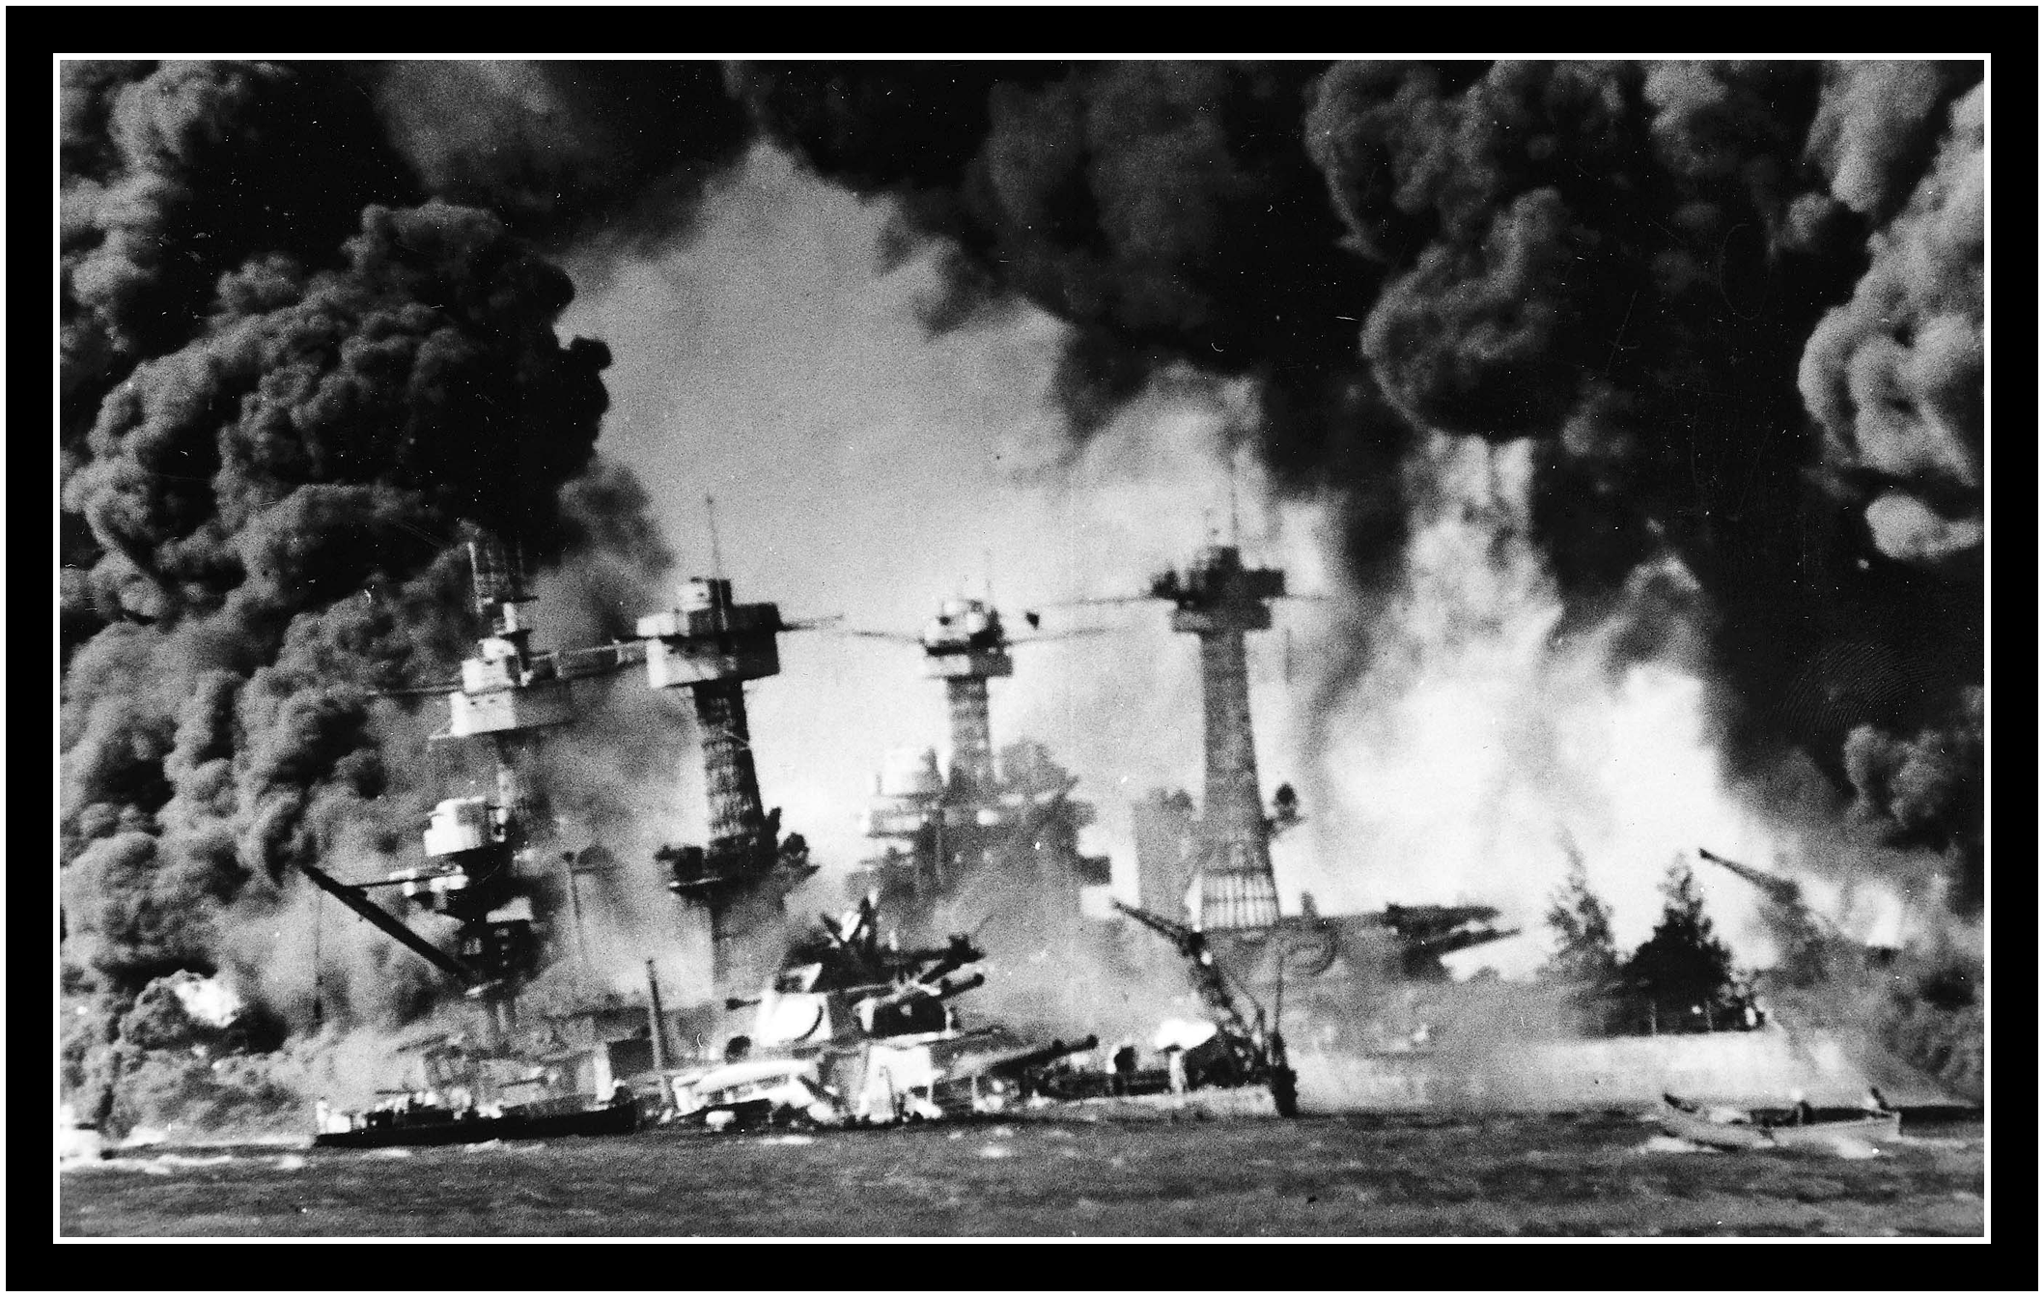
Japan’s Twentieth Century
Pearl Harbor bombed Dec. 7, 1941.

Slide 18
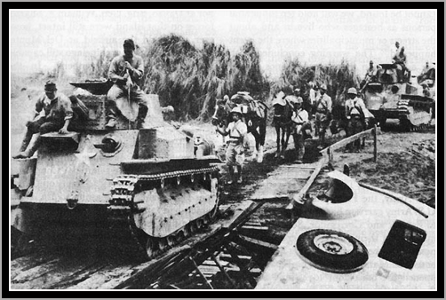
Japan’s Twentieth Century
Philippines: Dec. 8, 1941. (Actually the same day, just a couple of hours after Pearl – but history records the attack on 12/8/1941 because of the International Date Line.)

Slide 19
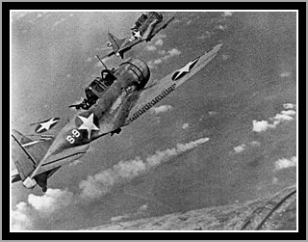
Japan’s Twentieth Century
Midway, 1942

Slide 20
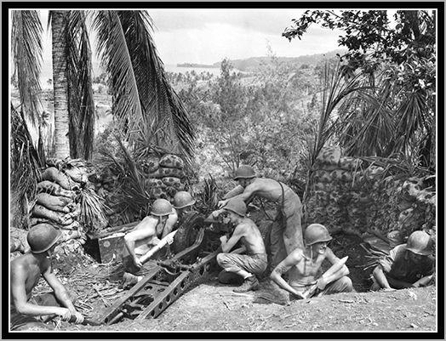
Japan’s Twentieth Century
Island Hopping

Slide 21
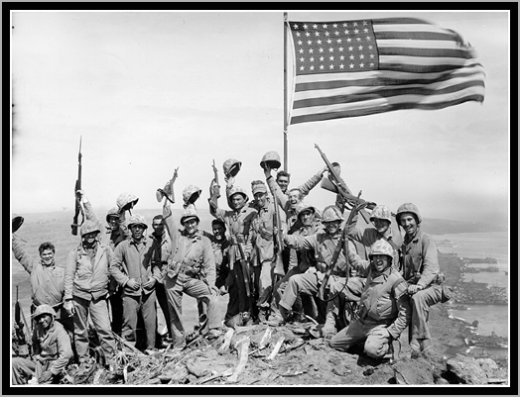
Japan’s Twentieth Century
Iwo Jima

Slide 22
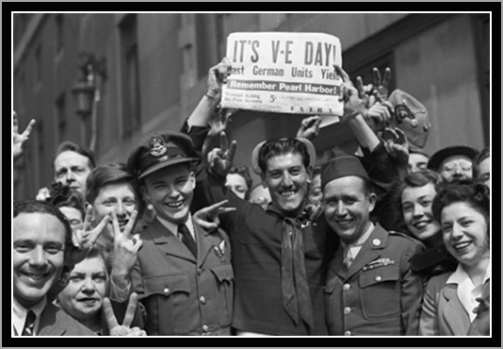
Japan’s Twentieth Century
V E Day: May 8, 1945

Slide 23
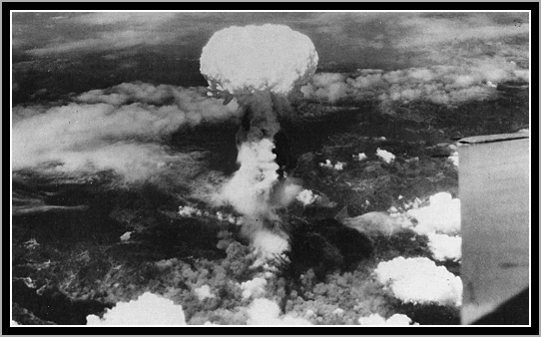
Japan’s Twentieth Century
August, 1945

Slide 24
Should the U.S. have done this?

Slide 25
Factors
The Japanese Military leadership was preparing for the sacrifice of the nation’s people.
Teaching women and children to fight with sharpened sticks.
Building a “Devine Wind” naval fleet.
Were indoctrinated that death was better than surrender – even in this 11th hour.

Slide 26
Factors
The Japanese Military leadership was preparing for the sacrifice of the nation’s people.
Truman was told that the invasion of the Japanese Homeland would cost 1,000,000 Japanese lives, and as many as 250,000 allied losses. He did not know anything about the Manhattan Project until FDR’s passing.

Slide 27
Facts
Given: The Japanese military leadership would not even entertain the thought of surrender.

Slide 28
Facts
Far more civilians died in the fire bombings in Tokyo prior to the dropping the atomic bomb.
Would it have been more humane to continue that course of action?

Slide 29
Facts
Far more civilians died in the fire bombings in Tokyo prior to the dropping the atomic bomb.
After both Hiroshima and Nagasaki were destroyed, the Japanese Hierarchy met to discuss their situation.
The Cabinet was equally divided - exactly half said that in light of the bombings in Hiroshima and Nagasaki, the country should surrender.
Exactly half said it was the duty of every Japanese citizen to die for their emperor – that surrender was unthinkable.

Slide 30
Facts
Far more civilians died in the fire bombings in Tokyo prior to the dropping the atomic bomb.
After both Hiroshima and Nagasaki were destroyed, the Japanese Hierarchy met to discuss their situation.
The Cabinet was equally divided - exactly half said that in light of the bombings in Hiroshima and Nagasaki, the country should surrender.
Exactly half said it was the duty of every Japanese citizen to die for their emperor – that surrender was unthinkable.
The Emperor Hirohito cast the deciding vote himself. This is one of only a handful of times when the Hirohito actually spoke in his counsel meetings. He asked that the Japanese people endure the unendurable so that the nation be preserved.

Slide 31
Facts
Far more civilians died in the fire bombings in Tokyo prior to the dropping the atomic bomb.
After both Hiroshima and Nagasaki were destroyed, the Japanese Hierarchy met to discuss their situation.
After the meeting concluded a radio broadcast was prepared with the emperor’s voice to break the news to the Japanese people.

Slide 32
Facts
Far more civilians died in the fire bombings in Tokyo prior to the dropping the atomic bomb.
After both Hiroshima and Nagasaki were destroyed, the Japanese Hierarchy met to discuss their situation.
After the meeting concluded a radio broadcast was prepared with the emperor’s voice to break the news to the Japanese people.
Japanese Army militants, members of the general staff itself, organized a cue attempt to destroy the recording and to kill Hirohito.

Slide 33
Facts
The cue would probably have succeeded if not for the very last night time bombing mission flown by US B29s over Tokyo… but, it failed.

Slide 34
Facts
The cue would probably have succeeded if not for the very last night time bombing mission flown by US B29s over Tokyo… but, it failed.
Emperor Hirohito’s voice was heard by the Japanese people, after which it would have been disgraceful for those seeking to prolong the war to carry out any further aggression towards the emperor. Many chose to end their own lives instead.

Slide 35
Understanding Japanese mindset
Books I recommend on WW II:
Flags of Our Fathers, James Bradley
The Last Mission, Jim B. Smith
Flyboys, James Bradley
A Dawn Like Thunder, Robert J. Mrazek
The Rape of Nanking, Iris Chang
If you are really interested, read the book (Flags of Our Fathers) – don’t watch the movie. The movie is okay, but is like a highlight reel, leaving out so many details. I believe this is an honest telling of a real life story, written by the son of one of the men who lifted the flag on Iwo Jima.

Slide 36
The Rest of the Story
With all the conflicts earlier between Russia and Japan (remember their border incidents over a 12 year period), when did Russia enter the Pacific Theater, to fight the Japanese during WWII?

Slide 37
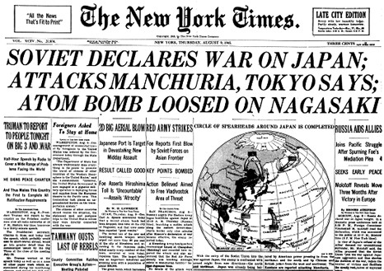
The Rest of the Story

Slide 38
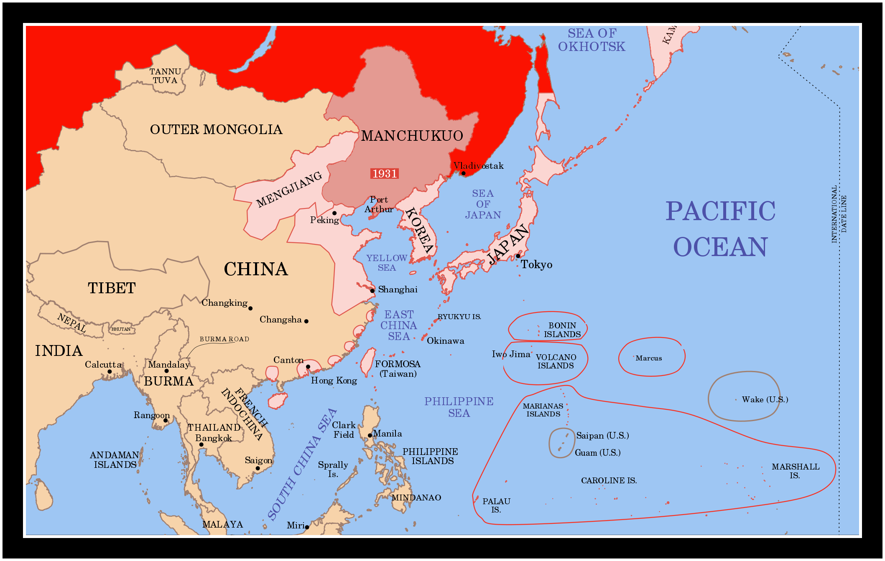
The Soviet Plan

Slide 39
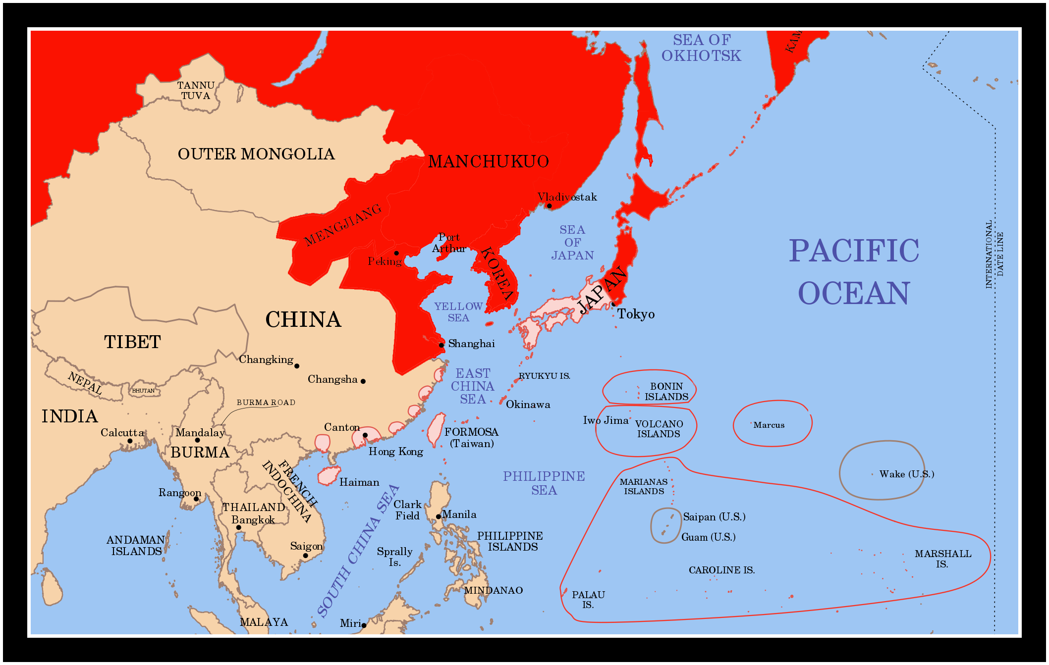
The Soviet Plan

Slide 40
The Soviet Plan
Wanted to divide and control significant portions of Asia, just like they did with Eastern Europe.
Other Allies, the US and the UK, held their ground and did not allow this Soviet takeover.

Slide 41
Osamu Tezuka
Coming Soon: The Mighty Atom

